Slide 1

Price-Promotion Elasticity
The marketing team would like to perform a price-promotion elasticity analysis and has reached out to Bryn’s team to help them build a model that will allow them to gain insight into how much demand changes when the marketing team applies discounts to products’ price. If you are not able to create this model, explain your approach.

Slide 2
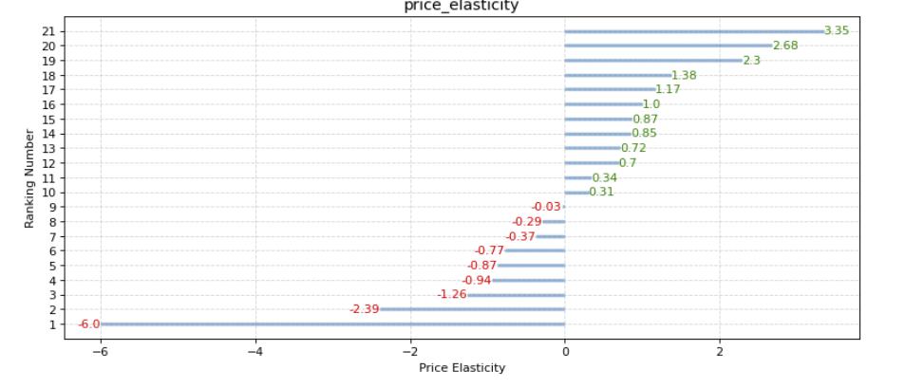
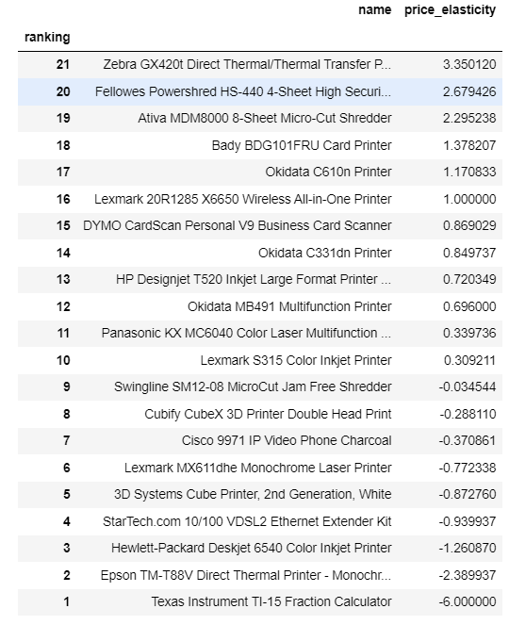
Texas Instrument & Epson demand is highly affected by discounts
Price Elasticity for Tech - Machines
Price Elasticity for Tech - Machines
We have several products for which the change in price will affect the demand. In this case, Texas Instrument, Zebra, Fellowes, and Epson demonstrate high elasticity. For example, as Texas Instrument decreases its price by 60%, demand increases on average by 45%.
Values between 0-1 are inelastic and therefore discounts will not affect sales.

Slide 3
Limitations of the Price & Promotion Model
Price Elasticity for Tech - Machines
Additional Steps:
Data preprocessing
(cleaning and better handling missing values)
Model selection/ fine-tuning (adjust the current model as the current one does not include a lot of data/ potential of overfitting; try other approaches)
Continue using several methods to validate the model
In the future, I would build price & promotions models per category to better access the complete data available.
Methodology: Linear Regression
Coefficient (Slope) * Price mean / Quantity mean
We used order date to captured different prices of the products

